Slide 1

Project Report
Course title : Physics Lab
Course code : PHY 104
Prepared by
Joy Pal – 201002418
Prothom Barman Rittik - 203002030

Slide 2

RAIN
ALARM
Device

Slide 3
Introduction
A rain alarm is basically a device which gives an alarm when the sensor is in contact with water.

Slide 4
Usage
Factories
open godowns
water level indicator
Irrigation field
Home automation
Automobiles etc.

Slide 5
Construction of Rain Alarm
n-p-n transistor (BC 147)
Resistors
Capacitor ceramic
Rain sensors
Buzzer
Battery
Timer
Switch

Slide 6
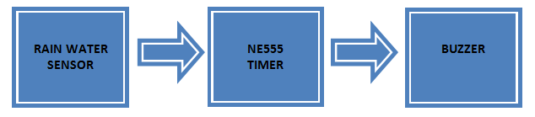
Block Diagram:

Slide 7
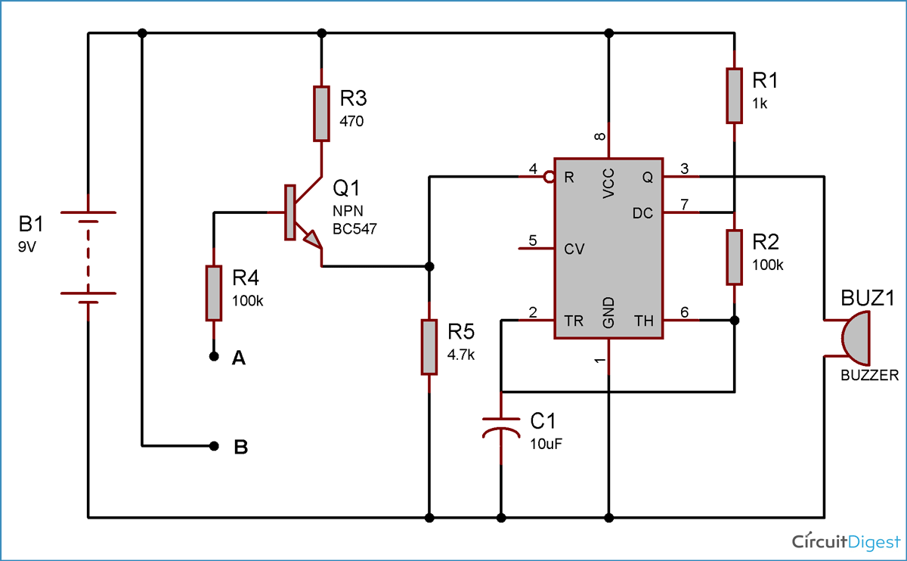
Circuit Diagram

Slide 8
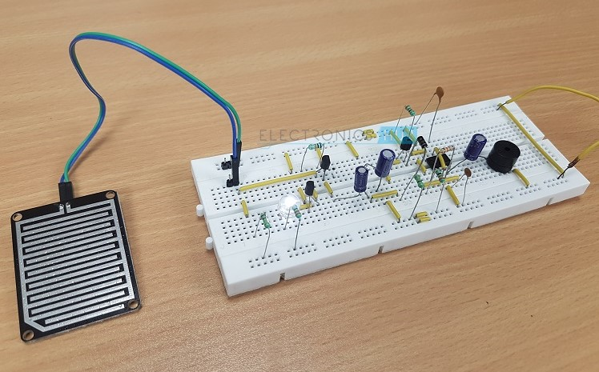
Rain Alarm Device

Slide 9
Advantages
It is very cheap.
The battery last very much.
Not risky.
No harmful effect.

Slide 10
Disadvantages
It doesn’t tell about the speed of the rain which is fallen of the roof.
It will send signal until the detector become wet.

Slide 11
Application
In the irrigation, it will detect the rain which is fallen on the roof.
It automobiles, when the rain detector detects the rain it will immediately active the wiper and inform the driver.

Slide 12
Conclusion
It is cheap to make. The circuit helps us to alarm from the rain. By designing this circuit we can check the level of water.

Slide 13
Thank you…

